Slide 1
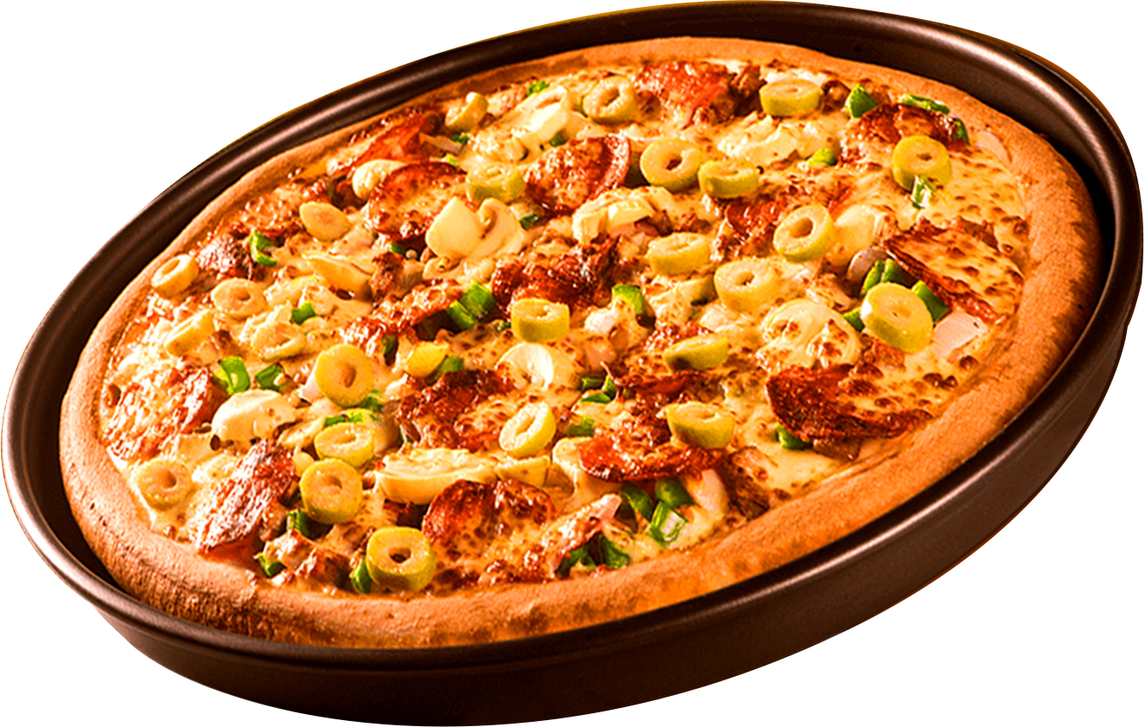
PIZZA SALES ANALYSIS
SQL Data Analysis Project
Presented By: Vaishnavi Badhe
Data Analyst Project
All About Pizza!

Slide 2

Hello !
Contact Us
Hello ! Am Vaishnavi Badhe , The Pizza Sales Analysis is a data analytics project that focuses on analyzing pizza sales data using SQL.
The main objective of this project is to understand sales performance, customer preferences, popular pizza categories, and revenue trends.
In this project, I used SQL queries to extract, analyze, and interpret meaningful insights from the pizza sales dataset.

Slide 3
Pizza Sales Analysis – SQL Project
SQL Project Questions
Basic Sales Analysis
Q1. Retrieve the total number of orders placed.
Q2. Calculate the total revenue generated from pizza sales.
Q3. Identify the highest-priced pizza.
Q4. Identify the most common pizza size ordered.
Pizza & Category Analysis
Q5. List the top 5 most ordered pizza types along with their quantities.
Q6. Join the necessary tables to find the total quantity of each pizza category ordered.
Q7. Join the relevant tables to find the category-wise distribution of pizzas.
Order & Time Analysis
Q8. Determine the distribution of orders by hour of the day.
Q9. Group the orders by date and calculate the average number of pizzas ordered per day.
Revenue Analysis
Q10. Determine the top 3 most ordered pizza types based on revenue.
Q11. Calculate the percentage contribution of each pizza type to total revenue.
Q12. Analyze the cumulative revenue generated over time.
Q13. Determine the top 3 most ordered pizza types based on revenue for each pizza category.
Project Objectives

Slide 4

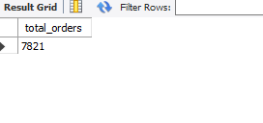
Q1) Retrieve the total number of orders placed.

Slide 5
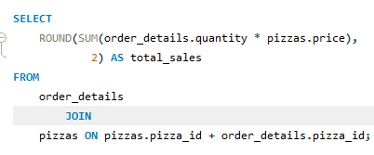

Q2) CALCULATE THE TOTAL REVENUE
GENERATED FROM PIZZA SALES.

Slide 6
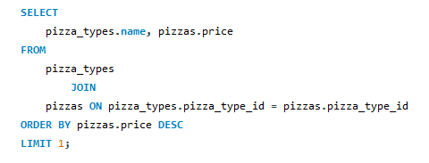

Q3) IDENTIFY THE HIGHEST-
PRICED PIZZA

Slide 7
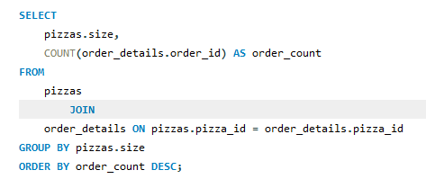
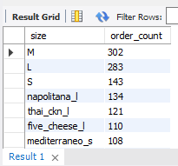
Q4) IDENTIFY THE MOST COMMON PIZZA SIZE ORDERED.

Slide 8
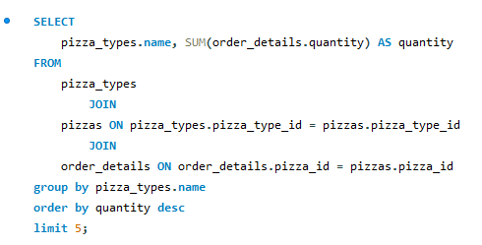
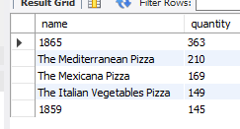
Q5) List the top 5 most ordered pizza types along with their quantities.

Slide 9
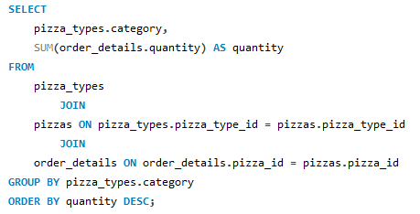
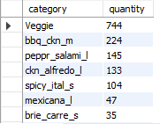
Q6) Join the necessary tables to find the total quantity of each pizza category ordered.

Slide 10
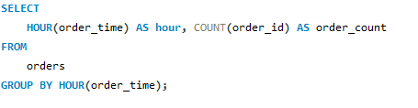
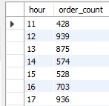
Q7)Determine the distribution of orders by hour of the day.

Slide 11
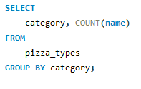
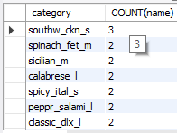
Q8) Join relevant tables to find the category-wise distribution of pizzas.

Slide 12
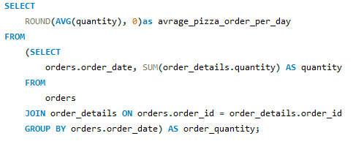

Q9) Group the orders by date and calculate the average number of pizzas ordered per day.

Slide 13
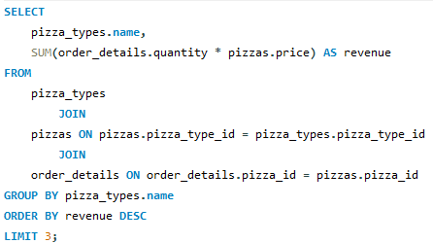

Q10) Determine the top 3 most ordered pizza types based on revenue.

Slide 14
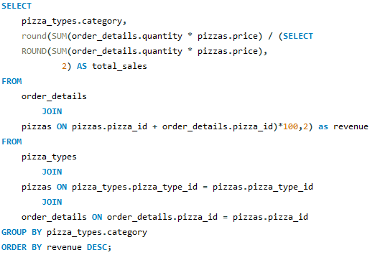
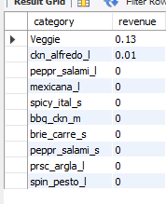
Q11) .Calculate the percentage contribution of each pizza type to total revenue.

Slide 15
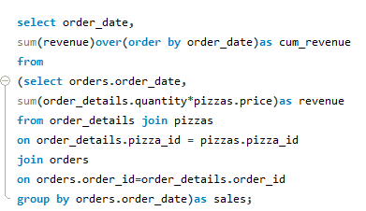
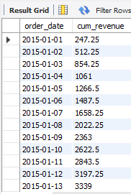
Q12) Analyze the cumulative revenue generated over time.

Slide 16
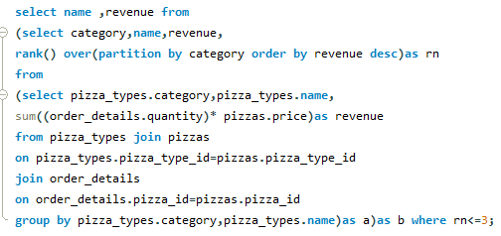
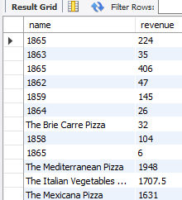
Q13)Determine the top 3 most ordered pizza types based on revenue for each pizza category.

Slide 17

CONCLUSION
In this Pizza Sales Analysis project, I successfully analyzed pizza sales data using SQL.
I performed various SQL queries to identify total orders, total revenue, best-selling pizzas, popular pizza sizes, category-wise sales, and revenue trends.
Through this project, I gained practical knowledge of SQL concepts such as JOIN, GROUP BY, ORDER BY, aggregate functions, and window functions.
This analysis helped me understand sales performance and generate meaningful business insights that can support better business decisions.
Overall, this project enhanced my SQL and Data Analysis skills.

Slide 18
THANK YOU
Pizza Sales Analysis
Presented By: Vaishnavi Badhe
Questions & Answers

